Slide 1


Unit – 5.1 Graph Theory - II
B.Tech., B.Sc.(H) CS $→$3rd Semester
Discrete Mathematics (2301HS301)
Prof. Dhvanik H. Zala
Department of Humanities & Science
dhvanik.zala@darshan.ac.in
82385 88865

Slide 2

Topics of Unit 5.1
Euler and Hamiltonian Paths and Circuits
(For Undirected Graph)
Introduction to Planar Graph
Introduction to Graph Coloring
Looping

Slide 3

Outline of Unit 5.1
Euler Paths and Circuits
Hamiltonian Paths and Circuits
Introduction to Planar Graph
Introduction to Graph Coloring
Looping

Slide 4

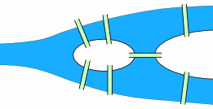
The Königsberg Bridge Problem
The city of Königsberg in Prussia (present-day Kaliningrad, Russia) was set on both sides of the Pregel River and included two large islands — Kneiphof and Lomse — that were connected to each other via the two mainland portions of the city by seven bridges.
Land
River
Island
Island
Land
Image Source: https://en.wikipedia.org/wiki/Seven_Bridges_of_K%C3%B6nigsberg
Image Source: https://www.mathsisfun.com/activity/seven-bridges-konigsberg.html

Slide 5
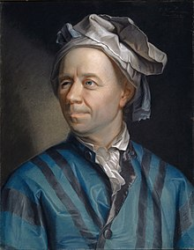
The Königsberg Bridge Problem
Can you take a walk through the town, visiting each part of the town
and crossing each bridge only once?
The Swiss mathematician Leonhard Euler solved this problem. His solution, published in 1736, may be the first use of graph theory.
Euler proved that the problem has no solution.
Image Source: https://en.wikipedia.org/wiki/Leonhard_Euler

Slide 6
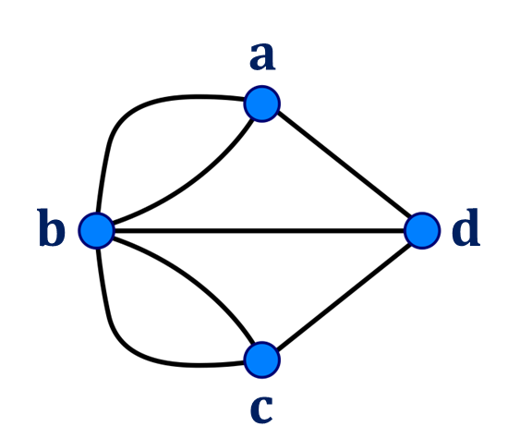
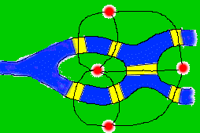
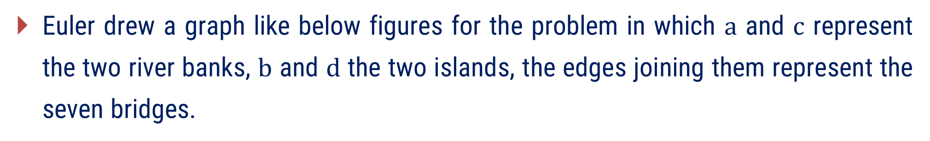
The Königsberg Bridge Problem
Euler drew a graph like below figures for the problem in which $a$ and $c$ represent the two river banks, $b$ and $d$ the two islands, the edges joining them represent the seven bridges.
Image Source: https://mathweb.ucsd.edu/~fan/152/class/konig.htm
Image Source: https://soulofmathematics.com/index.php/seven-bridges-of-konigsberg/
It is clear that the problem of walking each of the seven bridges exactly once and returning to the starting point is equivalent to finding a circuit in graph that traverses each of the edge exactly once.

Slide 7
Method – 1 Euler Paths and Circuits

Slide 8
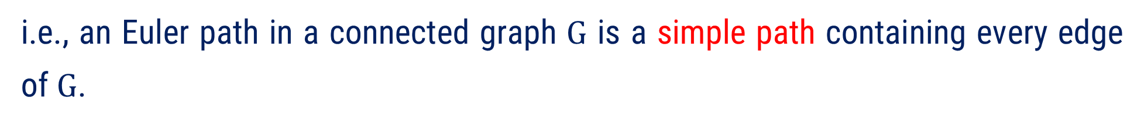
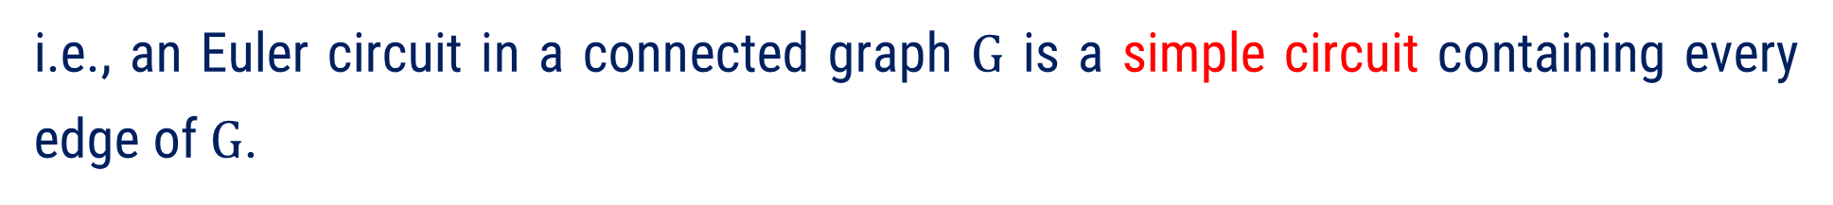
Euler Paths and Circuits
A circuit in a connected graph is an Euler Circuit if it contains every edge of the graph exactly once.
i.e., an Euler circuit in a connected graph $G$ is a simple circuit containing every edge of $G$.
A path in a connected graph is an Euler Path if it contains every edge of the graph exactly once.
i.e., an Euler path in a connected graph $G$ is a simple path containing every edge of $G$.
A connected graph which contains Euler circuit is called Euler or Eulerian Graph.

Slide 9
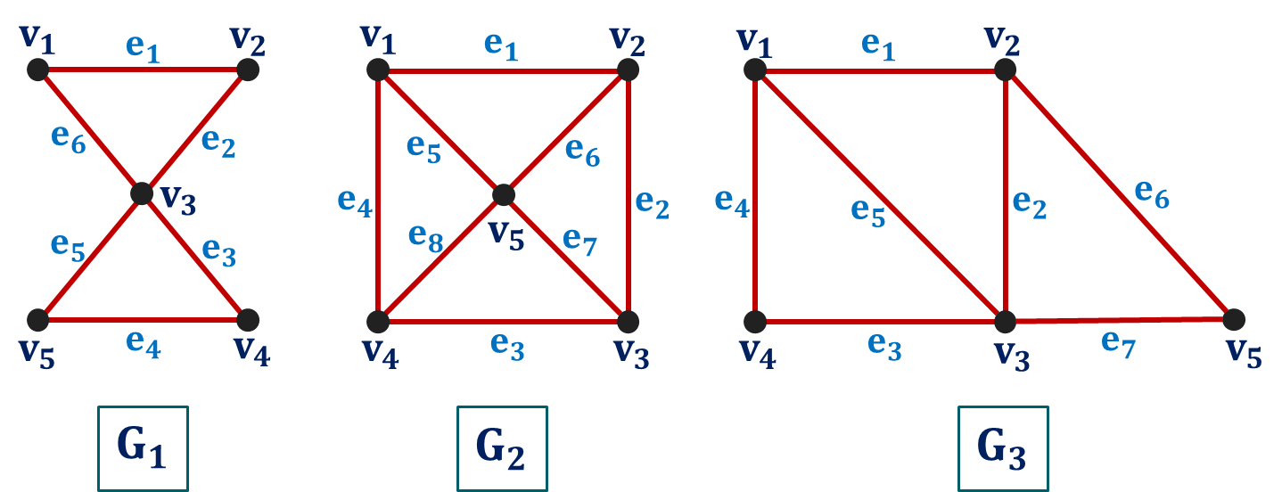
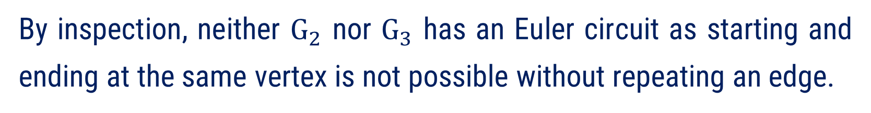
Method:1$⇝$Example:1
Example:1
Which of the following graphs have an Euler circuit? Of those that do not, which have an Euler path?
Solution:
The graph $G_{1}$ has an Euler circuit, $v_{1}e_{1}v_{2}e_{2}v_{3}e_{3}v_{4}e_{4}v_{5}e_{5}v_{3}e_{6}v_{1}$
By inspection, neither $G_{2}$ nor $G_{3}$ has an Euler circuit as starting and ending at the same vertex is not possible without repeating an edge.

Slide 10

Method:1$⇝$Example:1 (Continue)
The graph $G_{3}$ has an Euler path, $v_{1}e_{4}v_{4}e_{3}v_{3}e_{7}v_{5}e_{6}v_{2}e_{2}v_{3}e_{5}v_{1}e_{1}v_{2}$
By inspection, $G_{2}$ does not have an Euler path.

Slide 11
Some Results on Euler Paths and Circuits for Undirected Graph
Result : 1
A connected undirected multigraph with at least two vertices has an Euler circuit if and only if each of its vertices has even degree.
Result : 2
A connected undirected multigraph has an Euler path but not an Euler circuit if and only if it has two vertices of odd degree.

Slide 12
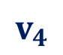
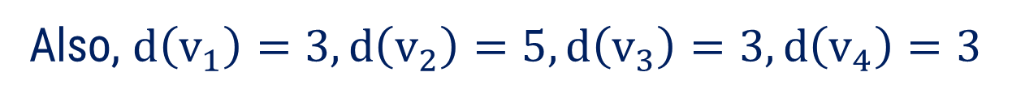
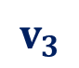
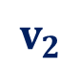

Method:1$⇝$Example:2
Example:2
Check whether the following graph is Euler Graph or not.
$$v_{1}$$
$$v_{2}$$
$$v_{4}$$
$$v_{3}$$
Solution:
Clearly, we can observe that the given graph is undirected as well as connected.
Also, $d\left(v_{1}\right)=3, d\left(v_{2}\right)=5, d\left(v_{3}\right)=3, d\left(v_{4}\right)=3$
So, the degree of all the vertices are odd.

Slide 13



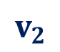
Method:1$⇝$Example:2 (Continue)
So, the degree of all the vertices are odd.
$$v_{1}$$
Thus, the given graph is not an Euler graph.
$$v_{2}$$
$$v_{4}$$
( Hence, in Königsberg Bridge Problem, it is impossible to walk through the town crossing each bridge exactly once and return home. )
$$v_{3}$$

Slide 14
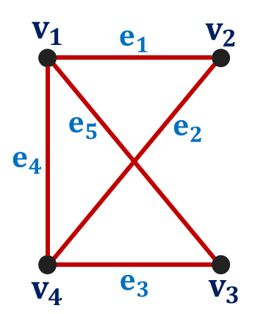
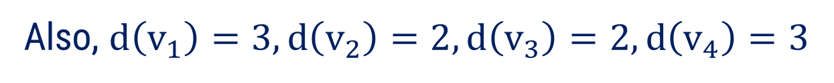
Method:1$⇝$Example:3
Example:3
Check whether the following graph has Euler path or not.
Solution:
Clearly, we can observe that the given graph is undirected as well as connected.
Also, $d\left(v_{1}\right)=3, d\left(v_{2}\right)=2, d\left(v_{3}\right)=2, d\left(v_{4}\right)=3$

Slide 15
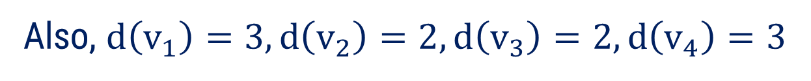
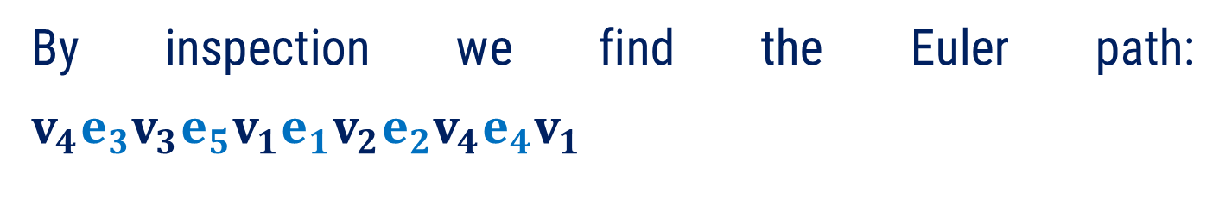
Method:1$⇝$Example:3 (Continue)
Also, $d\left(v_{1}\right)=3, d\left(v_{2}\right)=2, d\left(v_{3}\right)=2, d\left(v_{4}\right)=3$
So, the given graph has exactly two vertices of odd degree.
Hence, the given graph contains Euler path.
By inspection we find the Euler path: $v_{4}e_{3}v_{3}e_{5}v_{1}e_{1}v_{2}e_{2}v_{4}e_{4}v_{1}$

Slide 16
Euler Paths and Circuits
Steps to check whether the connected undirected graph has Euler path or Circuit
Step - 1
List the degree of all vertices in the graph.
Step - 2
If degree of any vertex is zero, then the graph is disconnected and hence it can not have Euler path or circuit.
Step - 3
If all the degrees are even, then the graph has both Euler path and Euler circuit.
Step - 4
If exactly two vertices are of odd degree, then the graph has Euler path but no Euler circuit.

Slide 17
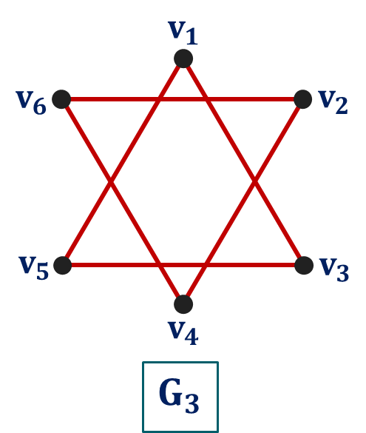
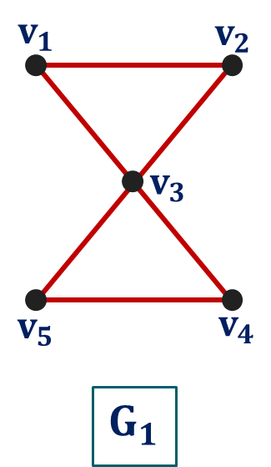


Method:1$⇝$Example:4
Example:4
Check whether the following graphs has Euler path and circuit or not.
Solution:
In $G_{1},$ all the vertices have even degree.
Therefore, $G_{1}$ has Euler path as well as Euler circuit.

Slide 18


Method:1$⇝$Example:4 (Continue)
In $G_{2},$ exactly two vertices has odd degree.
Therefore, $G_{2}$ has Euler path but it does not have an Euler circuit.
Graph $G_{3}$ is disconnected.
Therefore, $G_{3}$ has neither Euler path nor Euler circuit.

Slide 19




Method:1$⇝$Example:5
Example:5
For what values of $n$ is the graph of $K_{n}$ Eulerian?
Solution:
We know that complete graph $K_{n}$ with $n$ vertices is a connected graph in which degree of each vertex is $n−1$.
Since a graph is an Eulerian graph if and only if it is connected and degree of each vertex is even.
So, $n−1$ is even when $n$ is odd.
Hence, $K_{n}$ is Eulerian, when $n$ is odd.

Slide 20
Method – 2 Hamiltonian Paths and Circuits

Slide 21
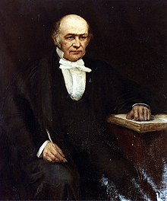
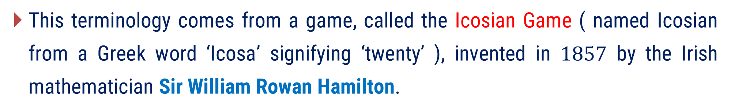
The Icosian Game
This terminology comes from a game, called the Icosian Game ( named Icosian from a Greek word ‘Icosa’ signifying ‘twenty’ ), invented in $1857$ by the Irish mathematician Sir William Rowan Hamilton.
Image Source: Wikipedia

Slide 22
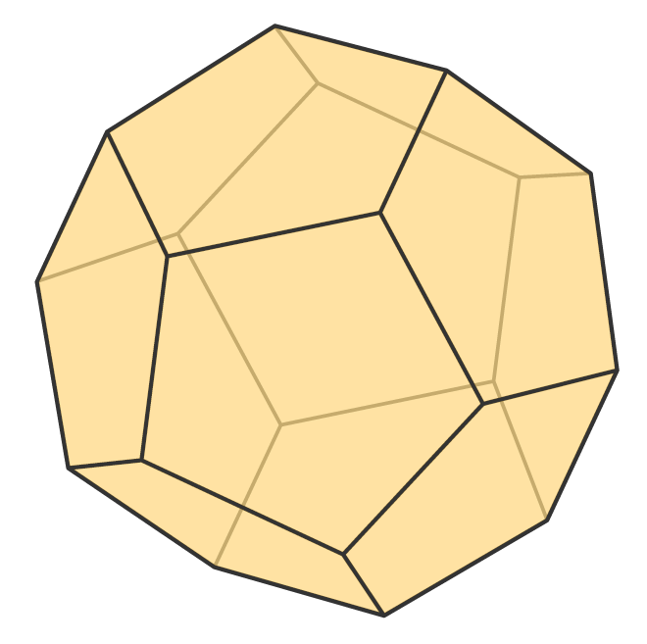
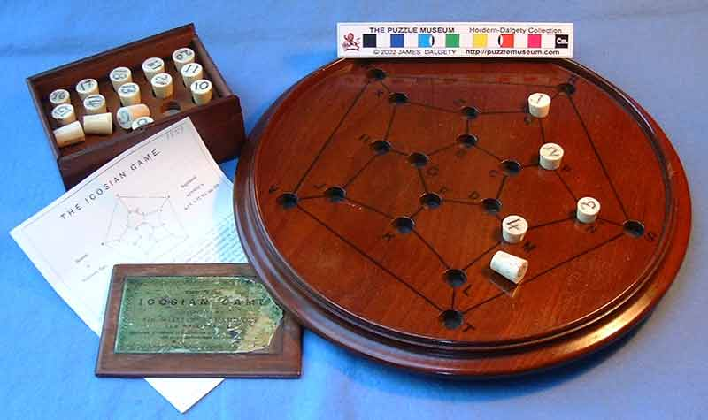
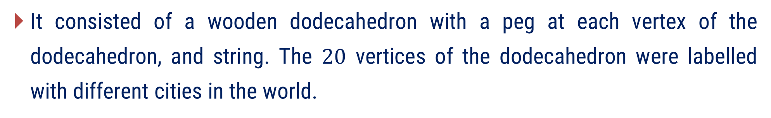


The Icosian Game
It consisted of a wooden dodecahedron with a peg at each vertex of the dodecahedron, and string. The $20$ vertices of the dodecahedron were labelled with different cities in the world.
$30$ edges
$20$ vertices
Image Source: Cuemath
Image Source: https://www.puzzlemuseum.com/month/picm02/200207icosian.htm

Slide 23
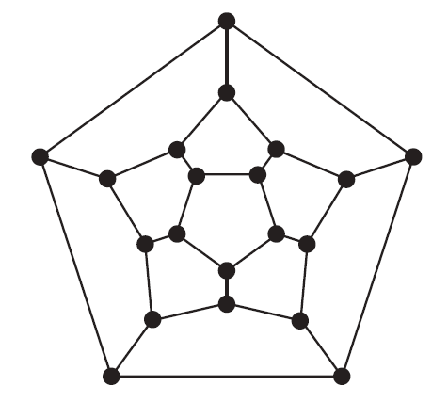
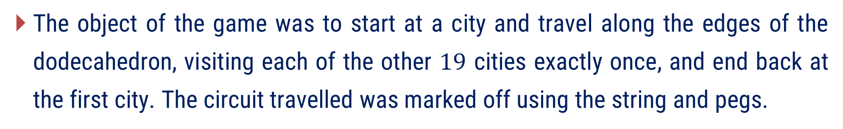
The Icosian Game
The object of the game was to start at a city and travel along the edges of the dodecahedron, visiting each of the other $19$ cities exactly once, and end back at the first city. The circuit travelled was marked off using the string and pegs.
An equivalent question: Is there a circuit in the graph shown in figure that passes through each vertex exactly once?
Image Source: Rossen Kenneth H

Slide 24
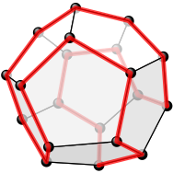
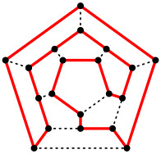
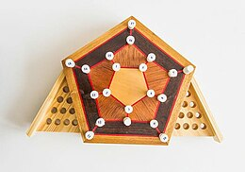
The Icosian Game
Solution of the icosian game: Hamiltonian Cycle
A Hamiltonian Cycle on a Dodecahedron
Planar view of Hamiltonian Cycle
Modern reconstruction of Hamilton's icosian game, on display at the Institute of Mathematics and Statistics, University of São Paulo
Image Source: Wikipedia

Slide 25
Hamilton Path and Circuit
A circuit which contains every vertex of the graph exactly once except end vertices is called Hamiltonian circuit.
A path in a graph is a Hamiltonian Path if it contains every vertex of the graph exactly once, where the end vertices may be distinct.
A graph which contains Hamiltonian circuit is called Hamiltonian Graph.

Slide 26
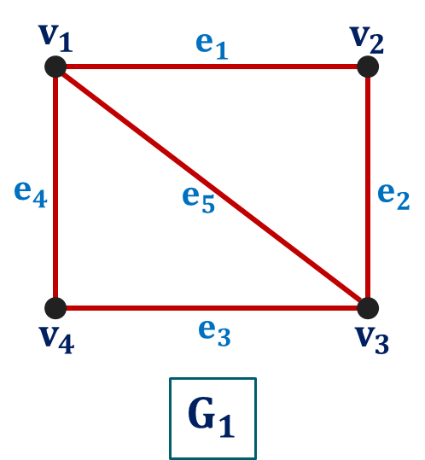
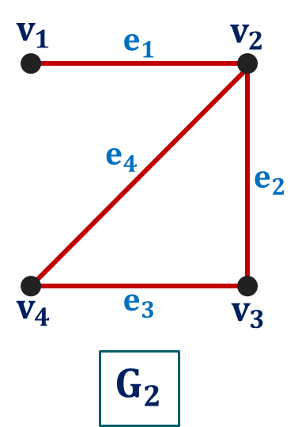
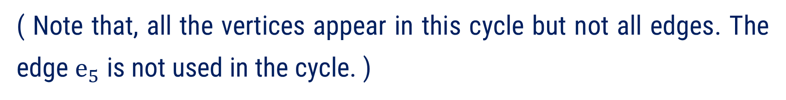
Method:2$⇝$Example:1
Example:1
Which of the following graph has a Hamiltonian cycle? If yes, give a cycle. If not, does it contain a Hamiltonian path? If yes, give a path.
Solution:
The graph $G_{1}$ has Hamiltonian cycle, $v_{1}e_{1}v_{2}e_{2}v_{3}e_{3}v_{4}e_{4}v_{1}$
( Note that, all the vertices appear in this cycle but not all edges. The edge $e_{5}$ is not used in the cycle. )

Slide 27

Method:2$⇝$Example:1 (Continue)
The graph $G_{2}$ does not contain Hamiltonian cycle since every cycle containing every vertex must contain the edge $e_{1}$ twice.
Graph $G_{2}$ has a Hamiltonian path, $v_{1}e_{1}v_{2}e_{2}v_{3}e_{3}v_{4}$.

Slide 28


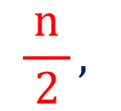
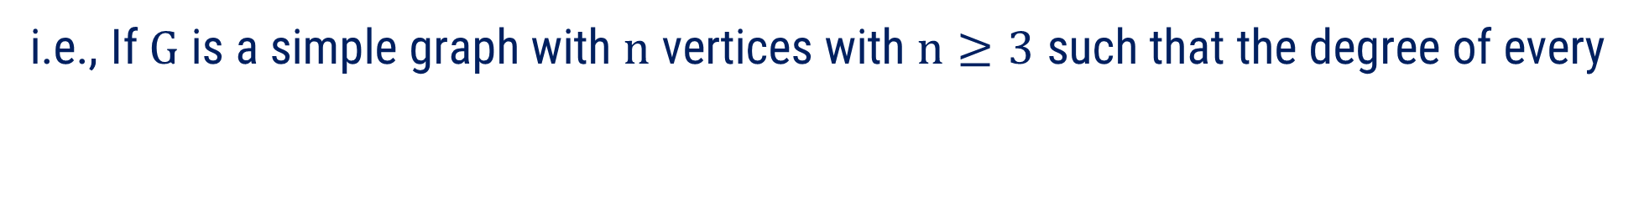
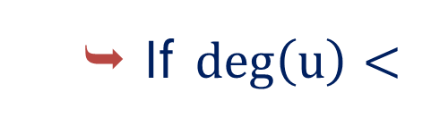
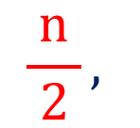
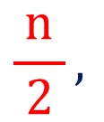
Some Results on Hamiltonian Paths and Circuits
Result : 1 (Dirac’s Theorem)
$$\frac{n}{ 2 },$$
If $G$ is a simple connected graph with $n$ vertices $\left(n≥3\right)$ such that $deg\left(u\right)≥$
for every vertex $u∈G$, then $G$ has a Hamiltonian circuit.
i.e., If $G$ is a simple graph with $n$ vertices with $n≥3$ such that the degree of every
$$\frac{n}{ 2 },$$
vertex in $G$ is at least
then $G$ has a Hamiltonian circuit.
Note
$\text{If} \deg\left(u\right)<$
$$\frac{n}{ 2 },$$
that does not mean that the graph is not Hamiltonian.

Slide 29
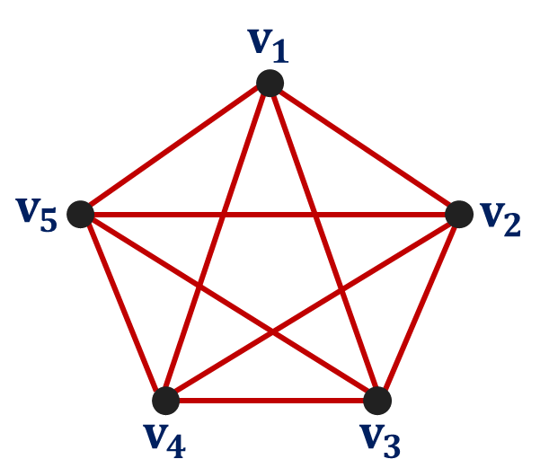

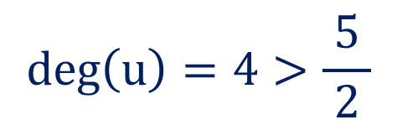

Method:2$⇝$Example:2
Example:2
Using Dirac’s Theorem show that the following graph is Hamiltonian graph.
Solution:
Here, the number of vertices $n=5$
$$\deg\left(u\right)=4>\frac{5}{ 2 }$$
Also, for each vertex $u∈K_{5}$,
From Dirac’s Theorem, the given graph has a Hamiltonian cycle and hence it is Hamiltonian graph.

Slide 30
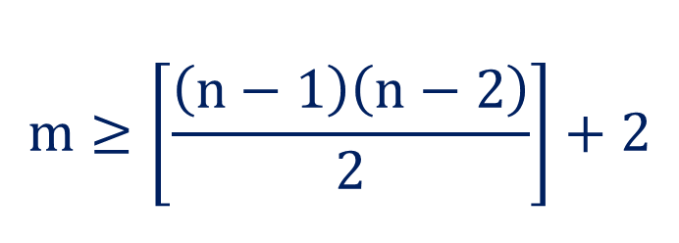

Some Results on Hamiltonian Paths and Circuits
Result : 2
If $G$ is a simple connected graph with $n$ vertices $\left(n≥3\right)$ and $m$ edges such that
$$m≥\left[\frac{\left(n−1\right)\left(n−2\right)}{2}\right]+2$$
then $G$ has a Hamiltonian circuit.
Note
The graph may be Hamiltonian even if, the above condition does not hold.

Slide 31
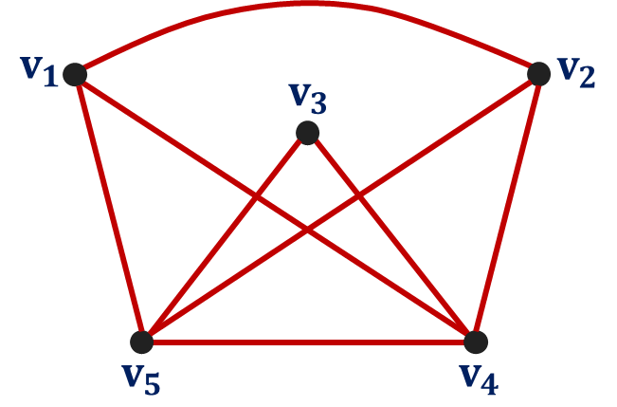
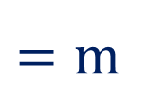

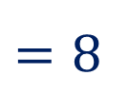
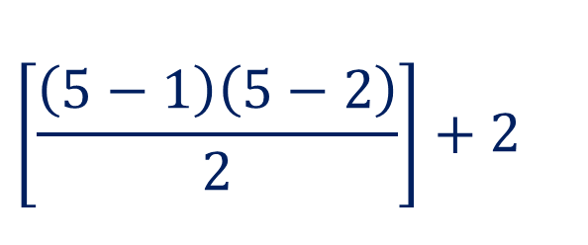
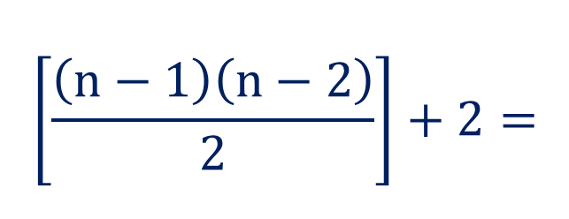
Method:2$⇝$Example:3
Example:3
Show that the following graph is Hamiltonian graph.
Solution:
Here, the number of vertices $n=5$ and the number of edges $m=8$
$$\left[\frac{\left(n−1\right)\left(n−2\right)}{2}\right]+2=$$
$$\left[\frac{\left(5−1\right)\left(5−2\right)}{2}\right]+2$$
Now,
$$=8$$
$$=m$$
Therefore, the given graph has a Hamiltonian circuit and hence it is Hamiltonian graph.

Slide 32

Some Results on Hamiltonian Paths and Circuits
Result : 3 (Ore’s Theorem)
If $G$ is a simple connected graph with $n$ vertices with $n≥3$such that
$$\deg\left(u\right)+\deg\left(v\right)≥n$$
for every pair of non – adjacent vertices $u$ and $v$ in $G$, then $G$ has a Hamiltonian circuit.
Note
The graph may be Hamiltonian even if, the above condition does not hold.

Slide 33
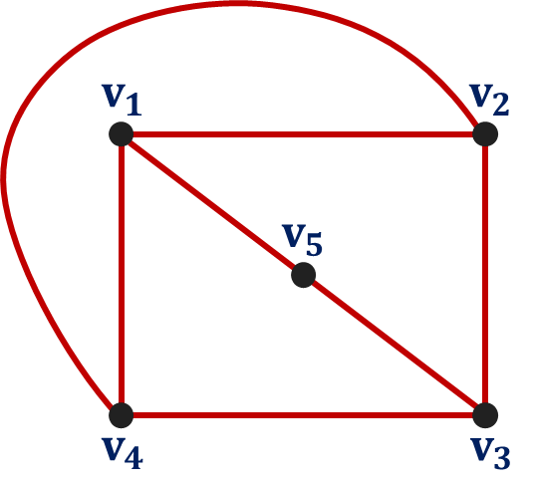


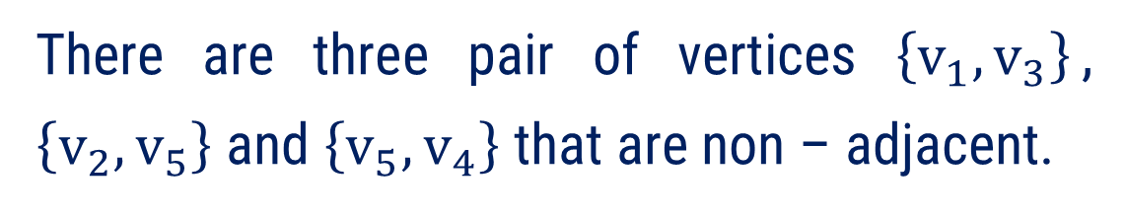

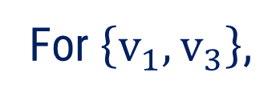
Method:2$⇝$Example:4
Example:4
Show that the following graph is Hamiltonian graph.
Solution:
Here, the number of vertices $n=5$.
There are three pair of vertices $\left\{v_{1}, v_{3}\right\}$, $\left\{v_{2}, v_{5}\right\}$ and $\left\{v_{5}, v_{4}\right\}$ that are non – adjacent.
For $\left\{v_{1}, v_{3}\right\}$,
$\deg\left(v_{1}\right)+\deg\left(v_{3}\right)=3+3=6≥5=n$
For $\left\{v_{2}, v_{5}\right\}$,
$\deg\left(v_{2}\right)+\deg\left(v_{5}\right)=3+2=5≥5=n$
For $\left\{v_{5}, v_{4}\right\}$,
$\deg\left(v_{5}\right)+\deg\left(v_{4}\right)=2+3=5≥5=n$

Slide 34

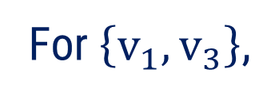

Method:2$⇝$Example:4 (Continue)
For $\left\{v_{1}, v_{3}\right\}$,
$\deg\left(v_{1}\right)+\deg\left(v_{3}\right)=3+3=6≥5=n$
For $\left\{v_{2}, v_{5}\right\}$,
$\deg\left(v_{2}\right)+\deg\left(v_{5}\right)=3+2=5≥5=n$
For $\left\{v_{5}, v_{4}\right\}$,
$\deg\left(v_{5}\right)+\deg\left(v_{4}\right)=2+3=5≥5=n$
From Ore’s Theorem, the given graph has a Hamiltonian cycle and hence it is Hamiltonian graph.

Slide 35


A Helpful Hints to Find a Hamiltonian Cycle
Let $G=\left(V, E\right)$ be a given graph.
If a graph has Hamiltonian cycle, then $\deg\left(u\right)≥2$, for all $u∈V.$
If $u∈V$ and $\deg\left(u\right)=2$, then the two edges incident with vertex $u$ must appear in every Hamiltonian cycle for $G$.
If $u∈V$ and $\deg\left(u\right)>2$, then as we try to build a Hamiltonian cycle, once we pass through vertex $u$, any unused edges incident with $u$ are deleted from further consideration.

Slide 36
Method:2$⇝$Example:5
Example:5
Give an example of a graph which contains
(1). an Eulerian circuit that is also a Hamiltonian circuit
(2). an Eulerian circuit but not Hamiltonian circuit
(3). a Hamiltonian circuit but not an Eulerian circuit
(4). a non – Eulerian and non – Hamiltonian circuit
(5). an Eulerian circuit and a Hamiltonian circuit that are distinct

Slide 37



Method:2$⇝$Example:5 (Continue)
Solution:
(1). an Eulerian circuit that is also a Hamiltonian circuit
The circuit $v_{1}e_{1}v_{2}e_{2}v_{3}e_{3}v_{4}e_{4}v_{1}$ in $G_{1}$ consists all edges, hence it is Eulerian Circuit.
The circuit $v_{1}e_{1}v_{2}e_{2}v_{3}e_{3}v_{4}e_{4}v_{1}$ also consists all vertices of $G_{1}$, hence it is Hamiltonian Circuit.

Slide 38



Method:2$⇝$Example:5 (Continue)
Solution:
(2). an Eulerian circuit but not Hamiltonian circuit
The circuit $v_{1}e_{1}v_{2}e_{2}v_{3}e_{3}v_{4}e_{4}v_{5}e_{5}v_{3}e_{6}v_{1}$in $G_{1}$ consists all edges, hence it is Eulerian Circuit.
$G_{2}$ does not contain Hamiltonian Circuit as every cycle containing every vertex will contain vertex $v_{3}$ twice.

Slide 39



Method:2$⇝$Example:5 (Continue)
Solution:
(3). a Hamiltonian circuit but not an Eulerian circuit
$G_{3}$ dos not contain Eulerian Circuit as degree of all the vertices are odd.
The circuit $v_{1}e_{1}v_{2}e_{2}v_{3}e_{3}v_{4}e_{8}v_{5}e_{5}v_{1}$ consists all vertices of $G_{3}$, hence it is Hamiltonian Circuit.

Slide 40



Method:2$⇝$Example:5 (Continue)
Solution:
(4). a non – Eulerian and non – Hamiltonian circuit
$G_{4}$ does not contain Eulerian Circuit as degree of all the vertices are not even.
$G_{4}$ does not contain Hamiltonian Circuit every cycle containing every vertex will contain at least one vertex twice.

Slide 41



Method:2$⇝$Example:5 (Continue)
Solution:
(5). an Eulerian circuit and a Hamiltonian circuit that are distinct
The circuit $v_{4}e_{4}v_{1}e_{1}v_{2}e_{2}v_{3}e_{3}v_{4}e_{5}v_{2}e_{6}v_{4}$ in $G_{5}$ consists all edges, hence it is Eulerian Circuit.
The circuit $v_{1}e_{1}v_{2}e_{2}v_{3}e_{3}v_{4}e_{4}v_{1}$ consists all vertices of $G_{5}$, hence it is Hamiltonian Circuit.

Slide 42




Summary
Hamiltonian Graph | Non - Hamiltonian Graph
Eulerian Graph
Non Eulerian Graph

Slide 43
Method – 3 Introduction to Planar Graph

Slide 44


Introduction
The $3$ Utilities Problem
The three utilities problem can be stated as follows:
Suppose three houses each need to be connected to the water, gas, and electricity companies, with a separate line from each house to each company. Is there a way to make all nine connections without any of the lines crossing each other?

Slide 45



Introduction
This problem can be modelled using the complete bipartite graph $K_{3,3}$.
The original question can be rephrased as: Can $K_{3, 3}$ be drawn in the plane so that no two of its edges cross?

Slide 46



Planar Graph
A graph $G$ is said to be planar if $G$ can be represented as a geometric picture on a plane such that there is no crossing over of edges of $G$.
A graph that cannot be drawn on a plane without a crossover between its edges is called non – planar graph.
Example
crossover
planar graph
non – planar graph

Slide 47



Remark
Note that if a graph $G$ has been drawn with crossing edges, this does not mean that $G$ is non – planar. There may be another way to draw the graph without crossovers.

Slide 48







Region of a Graph
A region of a planar graph is defined to be an area of the plane that is bounded by edges and is not further divided into sub – areas.
If the area of the region is finite, then the region is called finite region.
If the area of the region is infinite, then the region is called infinite, outer or unbounded region.
Example
$R_{4}$
Region $R_{6}$ in an infinite region while all other are finite regions.
$R_{2}$
$R_{6}$
$R_{3}$
$R_{1}$
$R_{5}$

Slide 49













Euler’s Formula
If a connected planar graph $G$ has $n$ vertices, $e$ edges and $r$ region, then
$n+r=2+e$.
OR
Any connected planar graph with $n$ vertices, $e$ edges has $e−n+2$ regions.
Example
Here, no. of vertices $=n=5,$
$R_{1}$
no. of edges $=e=7$
no. of regions $=r=4$
$R_{4}$
$R_{2}$
L.H.S.$=n+r$
$$=5+4$$
$R_{3}$
$$=9=2+e$$
$=$ R.H.S.

Slide 50











Method:3$⇝$Example:1
Example:1
Draw a planar graph representation of the following graph.
Solution:
$$v_{1}$$
$$v_{1}$$
$$v_{5}$$
$$v_{2}$$
$$v_{5}$$
$$v_{2}$$
$$v_{4}$$
$$v_{3}$$
$$v_{4}$$
$$v_{3}$$

Slide 51







Method:3$⇝$Example:2
Example:2
Draw a planar graph representation of the following graph.
Solution:
$$v_{5}$$
$$v_{1}$$
$$v_{3}$$
$$v_{4}$$
$$v_{6}$$
$$v_{2}$$

Slide 52




Method:3$⇝$Example:3
Example:3
Suppose that a connected planar simple graph has $20$ vertices, each of degree $3$. Into how many regions does a representation of this planar graph split the plane?
Solution:
Here, the number of vertices $=n=20$ and let $e$ be the number of edges.
Also, degree of each vertex is $3$,
by the First Theorem of Graph Theory,
$$\sum_{u ∈ V}{d\left(u\right)}=2e$$

Slide 53






Method:3$⇝$Example:3 (Continue)
$$\sum_{u ∈ V}{d\left(u\right)}=2e$$
$$∴20×3=2e$$
$$∴e=30$$
By Euler’s Formula, the number of regions is
$$r=e−v+2$$
$$∴r=30−20+2$$
$$∴r=12$$

Slide 54



Some Results on Simple Planar Graph
Result : 1
If $G$ is a connected planar simple graph with $e$ edges and $n$ vertices, where $n≥3$, then $e≤3n−6$.
i.e., If $G$ is a connected simple graph with $e$ edges and $n$ vertices, where $n≥3$, and $e>3n−6$, then $G$ is non – planar.
Remark
For a connected simple graph $G$ with $e$ edges and $n$ vertices, where $n≥3$, if $e≤3n−6$ that does not mean the graph is planar.

Slide 55










Method:3$⇝$Example:4
Example:4
Is $K_{5}$ ( Kuratowski’s First Graph ) planar?
Solution:
Let us assume that${ K}_{5}$ is planar. Also, we know that $K_{5}$is connected simple graph.
In $K_{5},$ the number of vertices $n=4$ and the number of edges $e=15$.
Now, $3n − 6$
Therefore, our assumption that $K_{5}$ is planar is wrong.
$$=3\left(4\right)− 6$$
$$=6$$
$$>15=e$$
Thus, $K_{5}$ is non – planar.
$$∴e≰3n − 6$$

Slide 56



Some Results on Simple Planar Graph
Result : 2
If a connected planar simple graph has $e$ edges and $n$ vertices with
$n$ $≥3$and no circuits of length three, then $e≤2n−4$.
i.e., Let $G$ be a connected simple graph with $e$ edges and $n$ vertices, where $n≥3$ and no circuits of length three. If $e>2n−4$, then the graph is non – planar.
Remark
For a connected simple graph $G$ with $e$ edges and $n$ vertices, where $n≥3$ and no circuits of length three. If $e≤2n−4$ that does not mean the graph is planar.

Slide 57









Method:3$⇝$Example:5
Example:5
Is $K_{3, 3}$ ( Kuratowski’s Second Graph ) planar?
Solution:
Clearly, $K_{3, 3}$ is simple and connected graph.
Also, it is easy to see that, $K_{3, 3}$ has no circuits of length $3.$
Now, in $K_{3, 3}$, the number of vertices $=n=6$ and the number of edges $=e=9$
Now, $2n−4=2\left(6\right)−4$
$$=8$$
$$<9=e$$
$$∴e≰2n−4$$
Thus, $K_{3,3}$ is non – planar graph.

Slide 58
Method – 4 Introduction to Graph Coloring

Slide 59

The Four Color Conjecture/Theorem
The first results about graph coloring deal almost exclusively with planar graphs in the form of map coloring. While trying to color a map of the counties of England.
Francis Guthrie postulated the four color conjecture, noting that four colors were sufficient to color the map so that no regions sharing a common border received the same color.
i.e., any planar graph can be colored using four colors.
Image Source: Wikipedia

Slide 60

The Four Color Conjecture/Theorem
At the time, Guthrie's brother, Frederick, was a student of Augustus De Morgan at University College London.
Francis inquired with Frederick regarding it, who then took it to De Morgan.
Image Source: Wikipedia

Slide 61


The Four Color Conjecture/Theorem
It seems to have been mentioned for the first time in writing in an $1852$ letter from Augustus De Morgan to W.R. Hamilton.
Letter of De Morgan to William Rowan Hamilton, 23 Oct. 1852
Image Source: Wikipedia

Slide 62


The Four Color Conjecture/Theorem
The proof of ‘four color conjecture’ was given Sir Alfred Bray Kempe in $1879$ and it stood for more than $10$ years.
For his accomplishment Kempe was elected a fellow of the Royal Society and later president of the London Mathematical Society.
Image Source: Wikipedia

Slide 63


The Four Color Conjecture/Theorem
In $1890$, Percy John Heawood pointed out that Kempe's argument was wrong.
However, in that paper he proved the five color theorem, saying that every planar map can be colored with no more than five colors, using ideas of Kempe.
Image Source: Wikipedia

Slide 64



The Four Color Conjecture/Theorem
The four color theorem was finally proved in $1976$ by Kenneth Appel and Wolfgang Haken.
Kenneth Appel
Wolfgang Haken
Image Source: Wikipedia and https://archon.library.illinois.edu/archives/index.php?p=digitallibrary/digitalcontent&id=11808

Slide 65

The Four Color Conjecture/Theorem
This proof used over a thousand cases, for which it required computer assistance: no human was able to verify the correctness of the proof.
Nevertheless, the proof was the start of a change in mathematicians' attitudes toward computers — which they had largely disdained as a tool for engineers rather than for theoreticians — leading to the creation of what is sometimes called experimental mathematics.
Wolfgang Haken (seated) and Kenneth Appel
Image Source: https://celebratio.org/media/cunit/None_cunit_fig11_1hzgxEo.jpg

Slide 66


Vertex Coloring
A coloring or vertex coloring of a simple graph is the assignment of a color to each vertex of the graph so that no two adjacent vertices are assigned the same color.
Example
$$G$$
$$H$$

Slide 67




Chromatic Number
The least (minimum) number of colors needed for a coloring of the graph is called the chromatic number of a graph.
The chromatic number of a graph $G$ is denoted by $χ\left(G\right).$
( Here $χ$is the Greek letter chi – read as Kai )
If $χ\left(G\right)=k,$ then $G$ is known as $k$ – chromatic.
Example
$$G$$
$χ\left(G\right)=2$
$G$ is $2 −$ chromatic.

Slide 68



Chromatic Number
Example
$$H$$
$χ\left(H\right)=2$
$H$ is $2−$ chromatic.

Slide 69



Method:4$⇝$Example:1
Example:1
Determine the chromatic number of following wheel graph $W_{6}$.
Solution:
$$∴χ\left(W_{6}\right)=4$$

Slide 70


Method:4$⇝$Example:2
Example:2
Find the chromatic number of following graph.
Solution:
$$∴χ\left(G\right)=4$$

Slide 71



Method:4$⇝$Example:3
Example:3
Show that $K_{5}$ is $5$ – chromatic.
Solution:
$$∴χ\left(K_{5}\right)=5$$
Hence, $K_{5}$ is $5$ – chromatic.

Slide 72
Chromatic Number of a Complete Graph ($K_{n}$)
The chromatic number of a complete graph $K_{n}$ with $n$ vertices is $n$.
Example

Slide 73




Chromatic Number of a Cycle Graph ($C_{n}$)
The chromatic number of a cycle graph $C_{n}$ with $n$ vertices is
$2$ if $n$ is even
$3$ if $n$ is odd
Example
$$C_{4}$$
$$C_{5}$$

Slide 74



Chromatic Number of a Bipartite Graph ($K_{m, n}$)
The chromatic number of a non – null graph is $2$ if and only if the graph is bipartite.
The chromatic number of a complete bipartite graph is $2$.
Example
$$K_{3, 2}$$
$$K_{3, 3}$$

Slide 75



Remarks
A graph consisting of only isolated vertices is $1$ – chromatic.
A chromatic number of a null graph is $1$.
$χ\left(G\right)≤n,$ where $n$ is the number of vertices of graph $G.$
If $deg\left(v\right)=d$ for a vertex $v$ in graph $G$, then at most $d$ colors are required for coloring of the vertices adjacent to $v$.
If $H$ is a subgraph of $G$, then $χ\left(H\right)≤χ\left(G\right).$

Slide 76

B.Tech. $→$3rd Semester
Discrete Mathematics (2301HS301)
THANK YOU
Prof. Dhvanik H. Zala
Department of Humanities & Science
dhvanik.zala@darshan.ac.in
82385 88865

